Slide 1



Green House Gas Emission Prediction
Phadatare Komal
https://github.com/komalphadtare1/GHG_emission-visualization-project

Slide 2

Learning Objectives
Learn how to import, preprocess, and combine annual supply chain emissions data from 2010–2016.
Understand how to use Python libraries like Pandas, NumPy, and Scikit-learn for data analysis and modeling.
Develop a regression model (e.g., RandomForestRegressor) to predict Supply Chain Emission Factors with Margins.
Use data visualization to explore key findings and relationships within the dataset.
GOAL

Slide 3
Tools and Technology used
Jupyter Notebook: The environment where the code was written.
Git: For version control.
Python: The programming language used.
Libraries:
Pandas
Numpy
Matplotlib
Seaborn
scikit-learn

Slide 4
Methodology
Data Collection :
Acquired emission data (2010–2016) categorized by industry and commodity.
Data Preprocessing:
Handled missing values, encoded categorical features, and scaled numerical data.
Feature Engineering:
Extracted relevant descriptive and quality metrics (e.g., reliability, unit, temporal/geographical/technological correlation).
Model Selection:
Used Random Forest Regressor for handling both numeric and categorical data.
Model Training & Tuning:
Split data into training and testing sets.
Applied GridSearchCV for hyperparameter tuning.
Model Evaluation:
Evaluated using RMSE and R² Score.

Slide 5
Problem Statement:
You have annual supply chain emission data from 2010–2016 categorized into industries and commodities. The goal is to develop a regression model that can predict the Supply Chain Emission Factors with Margins based on descriptive and quality metrics (substance, unit, reliability, temporal/geographical/technological/data collection correlations, etc.).
https://github.com/komalphadtare1/GHG_emission-visualization-project

Slide 6
Solution:
Data Analysis
Performed using Pandas and NumPy for cleaning, inspecting, and transforming structured tabular data.
Visualized patterns and distributions using Seaborn and Matplotlib.
Model Selection: Random Forest Regressor
Chosen for its ability to handle both numerical and categorical data effectively.
Works well with non-linear relationships and complex feature interactions.
Reduces overfitting through ensemble learning (multiple decision trees).
Why Random Forest?
Handles missing values and unscaled data relatively well.
Provides feature importance, aiding interpretability.
Robust to noise and outliers.
Preprocessing
Categorical features encoded using LabelEncoder.
Features standardized using StandardScaler for improved model performance.

Slide 7
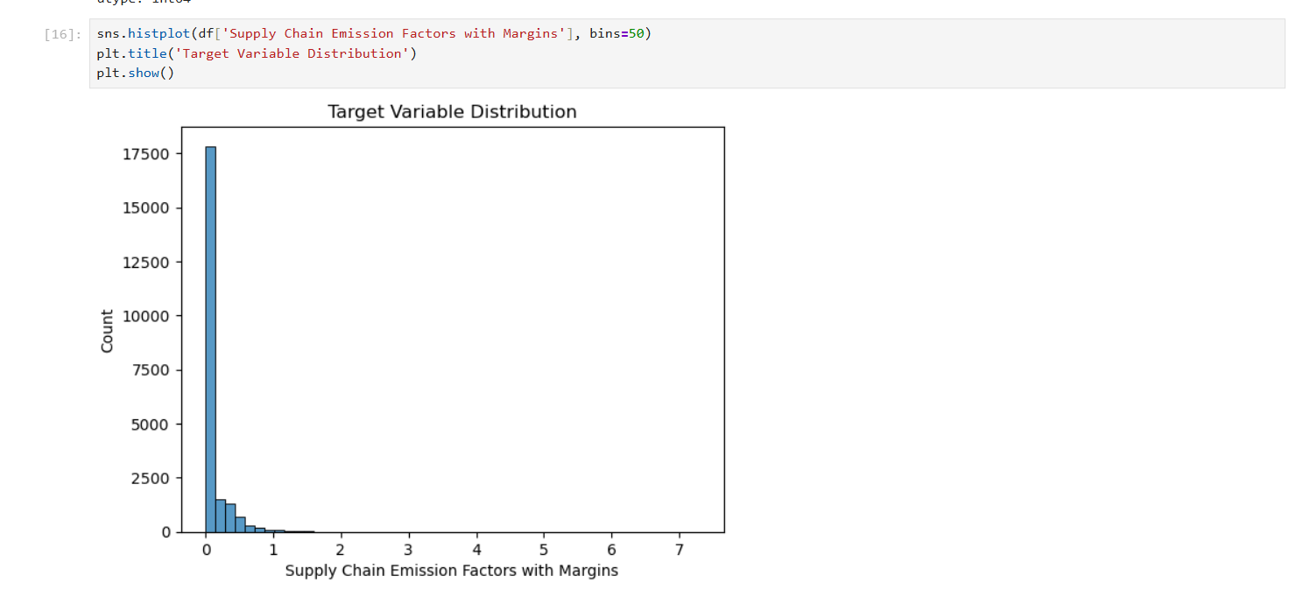
Screenshot of Output:
Fig 1
Fig 1 shows : The target variable shows a right-skewed distribution, indicating that most supply chain emission factors are low, with a few high-emission outliers driving the long tail.

Slide 8
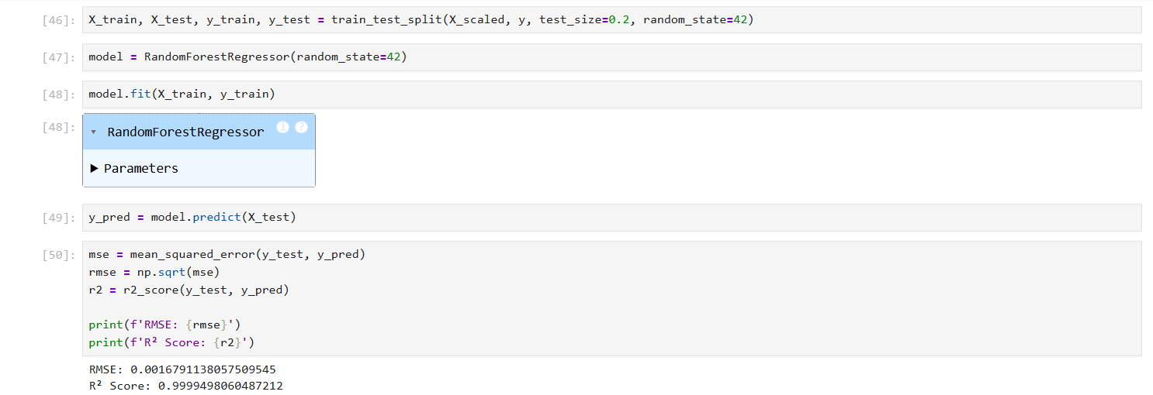
Fig 2
Fig 2 shows : The Random Forest model achieved excellent performance with an R² score of 0.9999 and a very low RMSE of 0.00167, indicating highly accurate predictions on the test set.

Slide 9
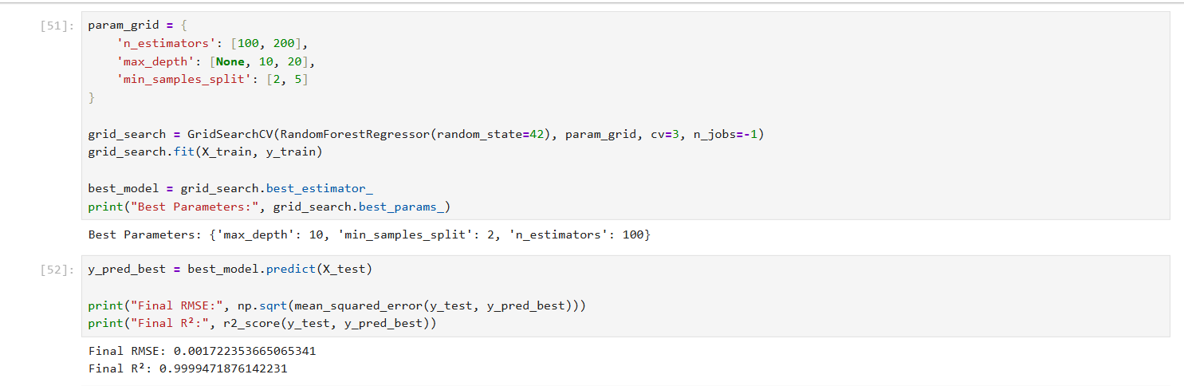
Fig 3
Fig 3 shows : GridSearchCV tuning of the Random Forest model further optimized its performance, achieving an R² of 0.9999 and RMSE of 0.00172 using the best parameters.
https://github.com/komalphadtare1/GHG_emission-visualization-project

Slide 10
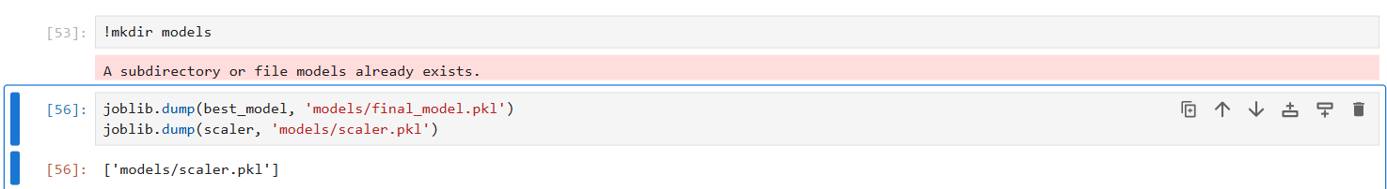
Fig 4
Fig 4 shows : The final model and scaler were serialized and saved using joblib, enabling seamless reuse and deployment of the trained pipeline.
https://github.com/komalphadtare1/GHG_emission-visualization-project

Slide 11
Conclusion:
In this project, we aimed to model and predict supply chain emission factors using machine learning. After analyzing the data, we observed that the target variable was highly right-skewed, with most values concentrated near zero and a few extreme outliers. To address this, we carefully prepared the data using feature scaling and proceeded with model training.
A Random Forest Regressor was employed due to its robustness and ability to handle non-linear relationships. The model initially achieved exceptionally high performance with an R² score of 0.9999 and a very low RMSE, indicating highly accurate predictions.
To further enhance the model, GridSearchCV was used to tune hyperparameters. The optimized model maintained excellent accuracy, confirming that the initial model was already close to optimal. Final performance metrics remained nearly the same after tuning, with an R² of 0.9999 and RMSE of 0.00172.
Finally, both the trained model and the scaler were using joblib to ensure reproducibility and ease of deployement. These saved components can now be integrated into production pipelines for automated emission predictions.
https://github.com/komalphadtare1/GHG_emission-visualization-project

Slide 12
THANKYOU

